Slide 1
Spring Boot Application Repository Layer Testing

Slide 2
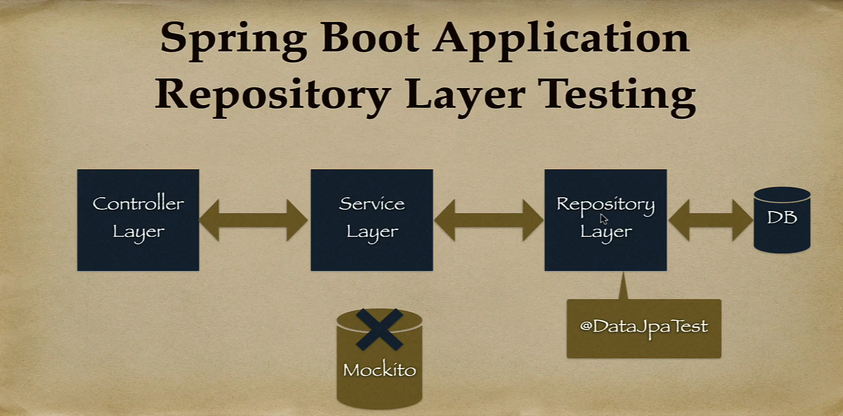

Slide 3
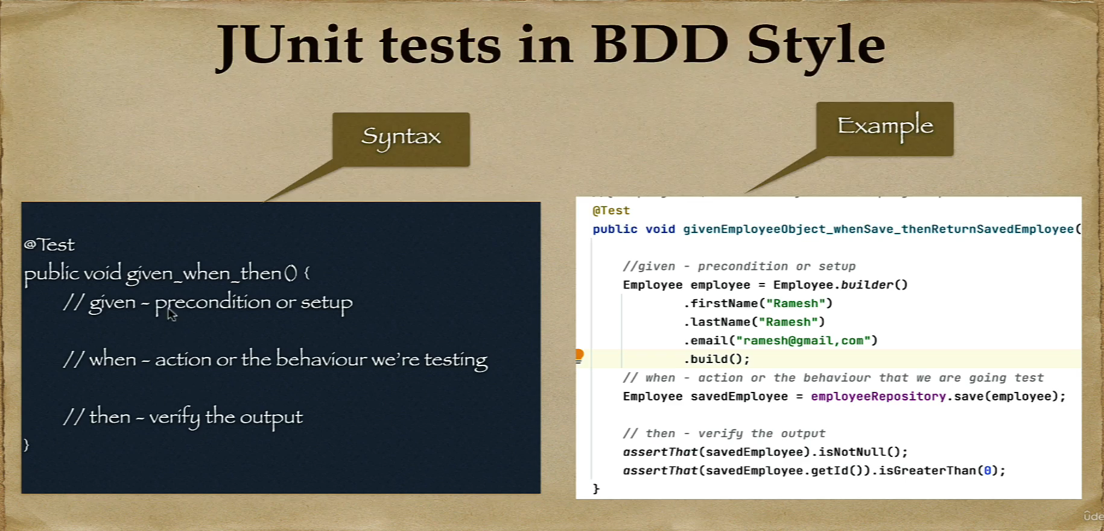

Slide 4
@DataJpaTest annotation

Slide 5
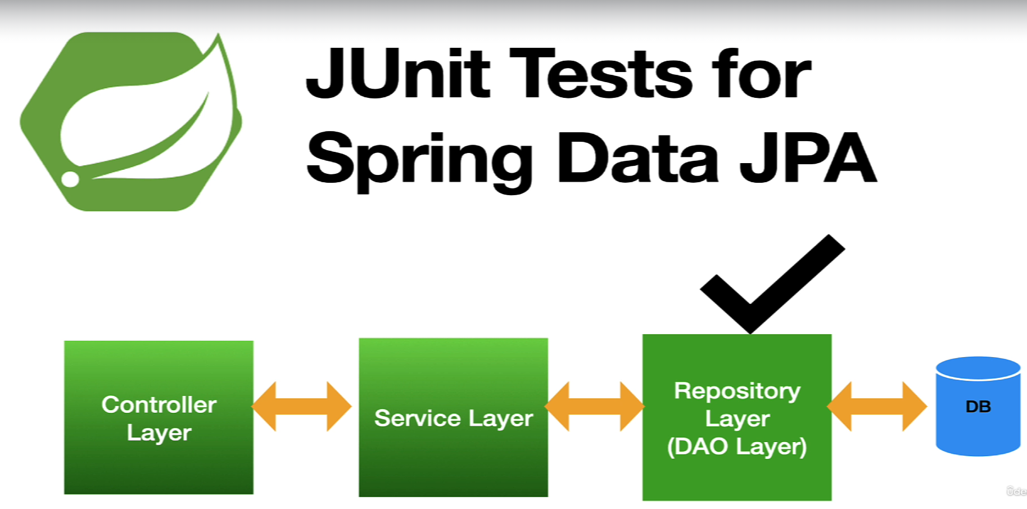

Slide 6
@DataJpaTest annotation
Spring Boot provides the @DataJpaTest annotation to test the persistence layer components that will autoconfigure in-memory embedded database for testing purposes.
The @DataJpaTest annotation doesn’t load other Spring beans (@Components, @Controller, @Service and annotated beans) into ApplicationContext.
By default, it scans for @Entity classes and configures Spring Data JPA repositories annotated with @Repository annotation.
By default, tests annotated with @DataJpaTest are transactional and roll back at the end of each test.

Slide 7
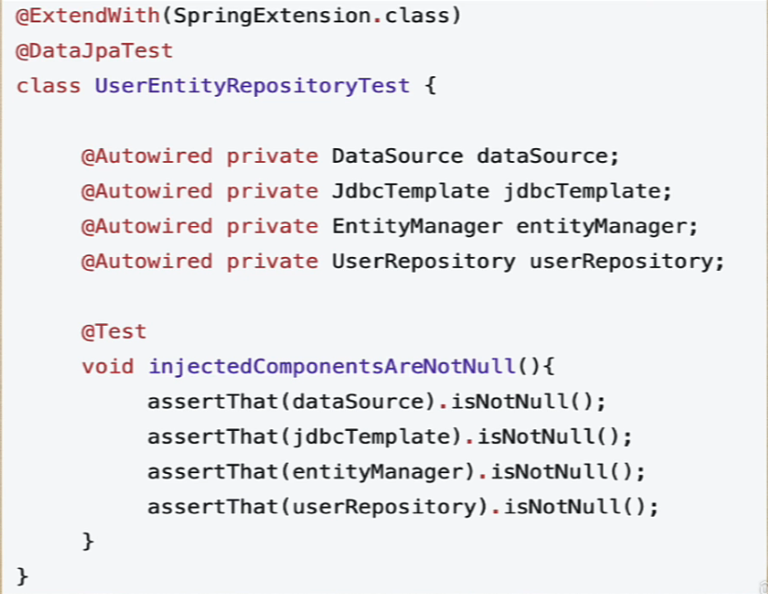
@DataJpaTest annotation
To test Spring Data JPA repositories or any other JPA-related components for that matter, Spring Boot provides the @DataJpaTest annotation.

